Slide 1



Free online
homework help
tutoring and test prep
Make Homework Time a Happy Time
How to use Tutor.com through
[enter library’s name]
Notes:
Provide a short intro to yourself and your library. Ask some questions to loosen up the crowd. “How many of you cringe when your child asks for help with math homework?” “Do homework wars put a damper on family dinner time?” You’ll want to use something to show empathy or even a “been there, done that” kind of story about your own school stress. Then, lead into the presentation with something such as “We have help. Tutor.com, a service provided to you through the library, can make homework time a happy time.”

Slide 2



Tutor.com Learning Suite Components
Real-Time Tutoring
3,000+ expert tutors
60+ subjects & test prep areas
K-College + Adult
No appointment needed
[enter hours]
Drop Off Reviews
Essays/Writing
Resumes/Cover Letters
Math Questions
  Algebra through Calculus
Self-Study Tools
SAT®/ACT® Essentials
AP® Test Prep Videos
Learn Your Way Videos
SkillsCenter™
Practice Quizzes
Test names are registered trademarks of their respective owners.
Notes:
The Tutor.com Learning Suite helps students learn their way by providing several different tools that incorporate visual, auditory, verbal and hands-on learning. We can categorize the different tools into three main components: real-time online tutoring, drop-off reviews and self-study tools. We’ll take a look at each of these components as we go through the presentation, but let’s start by talking about the tutoring.
With a library card and an internet connection, your student can connect to an expert tutor for just-in-time homework help or conceptual tutoring. Tutor.com has over 3,000 tutors available to assist in over 60 different subjects and test prep areas. They cover grades K through college and also offer tutoring for adults. No appointment is needed. The tutors are available from [insert tutoring hours and days].

Slide 3







The Tutors
Notes:
You might be wondering who are these tutors? How do I know they’ll be able to help my student? And, is it a safe online environment? Let me start by saying that Tutor.com has almost 20 years of experience with providing online tutoring. They’ve served over 16 MILLION sessions and have a proven track record for both safety and positive educational results.
All tutoring sessions take place in a safe and secure online classroom and students and tutors always remain anonymous to each other. All sessions are recorded for student & tutor safety, as well as for quality control purposes. We’ll take a look at the online classroom and learning environment soon. First, let me tell you more about the tutors.

Slide 4
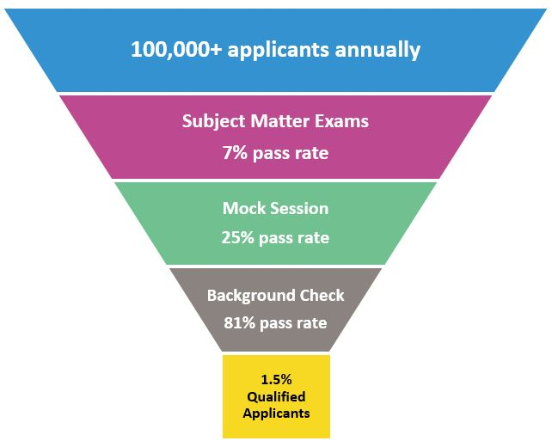
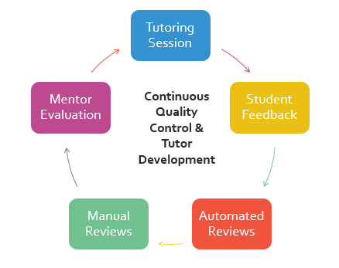
Carefully screened & fully monitored
Notes:
[note to librarian presenter: this slide may seem like a lot of information to present, but the purpose of including so much detail is to help the parents and teachers feel more at ease and comfortable with allowing their students to connect with a “stranger in an online environment.” So, don’t be afraid to stress the level of rigor through which we put our applicants and tutors.]
Tutor.com receives over 100,000 applications to become a tutor each year. This means they are very selective in who they qualify and accept.
To apply as a tutor, the first step is to complete an online application at www.tutor.com/apply. Tutors must meet a set of minimum requirements to be invited to continue through the process. For those meeting the minimum requirements, Tutor.com thoroughly tests their level of expertise for every subject in which they wish to tutor. The exams are so rigorous, that only 7% of these applicants pass and move on to stage two of the vetting process.
For those few that do pass, the next step is to learn more about Tutor.com’s pedagogy, procedures, policies and technology. Tutor.com provides the applicants with videos and instruction and then they put the applicants through a mock session to test their ability to apply their knowledge in an on-demand, online tutoring session. 25% will pass this stage which then moves them into a thorough background check that includes criminal history checks, employment eligibility and education. By this time in the process, Tutor.com has weeded out nearly 98,000 applicants, so it is great news that over 81% of the remaining 2,000 or so will pass this background check. When you put it all together, on average, only 1.5% of applicants are able to become qualified tutors which shows the high level standards Tutor.com keeps in place.
Once a tutor begins working with a student, the work of the tutor is constantly monitored. Background checks sweeps are rerun every three months, and Tutor.com uses several systems to ensure your child is safe and receiving effective instruction in the classroom. A big part of this quality control process is reviewing the student comments left the end of each tutoring session. Please make sure your student always leaves a comment and completes the survey so we know how they feel the session went. Also, every tutor is assigned to a certified mentor who provides support, session monitoring and professional development for tutors. In addition to the student feedback and mentor reviews, Tutor.com’s quality control team also keeps an eye on things through frequent and consistent transcript and performance reviews.
[pause for questions if you have time]
Now that we know more about the tutors, let’s talk about how they’ll work with your students.

Slide 5

The Instruction
Notes:
While safety is the #1 priority at Tutor.com, quality of the learning experience is a very close second. Tutor.com uses a well documented pedagogy or method of instruction that has been used in effective classrooms for decades. Tutors are guided by six principles of student-centered learning.

Slide 6
Student-centered instruction
Build off of the student’s foundation Tutors begin each session by identifying students’ existing knowledge and identifying gaps in student learning. | Provide instruction relevant to student. Clarify & utilize methods used in classroom so instruction is aligned to curriculum and standards. | Let the student think it through and do it. Tutors use leading questions and examples do demonstrate key concepts—students do the work.
Present information in multiple formats. Tutors leverage the Online Classroom’s chat, whiteboard and sharing tools to provide multi-modal instruction | Stop the stress before it begins. Tutors are available with no appointment needed, from any internet connection when students need them most. | Create a positive learning experience. Tutors build students’ confidence while addressing gaps in knowledge, encouraging them to try and showing them it’s possible.
Notes:
First and foremost, instruction is tailored to the student’s individual needs and knowledge level. This level of one-to-one attention is something that a lot of teachers do not have time to provide in class and for many parents, the way things are taught these days makes it hard to help. Tutor.com works to identify your student’s individual learning needs for each session and then uses a variety of instructional tools to help your student understand and complete their own work, all while offering patient guidance and encouragement. Keep in mind, the tutors do not give answers and they won’t do the work for the student. Every student is expected to remain engaged with the tutor throughout the session and work to build a better understanding of the material. While there is no set time limit for an individual session, the average session runs 20-25 minutes, sometimes shorter if the student has demonstrated understanding, sometimes longer if they need additional guidance. The goal of each session, though, is to make the student self-sufficient in their work, so bare in mind that tutors will not work through an entire worksheet or assignment with a student.
How can this service help your child? Let’s look at what the Tutor.com Learning Suite has to offer.

Slide 7
Delete this slide prior to presentation
In this section, be sure to use only the slides that are appropriate to your audience. We have broken the section into K-5th, 6th-8th and 9th-12th grade.

Slide 8

Focus on K-5th Grade
Notes:
As parents (or teachers) of elementary school students, it is important to help your student get off on the right foot and build a strong foundation of knowledge and healthy study habits. Tutor.com is here to help.

Slide 9





On-demand tutoring & homework help
Subjects Available
Basic Math
Basic Science
Language Arts
  Reading
  Writing
  ESL
Social Studies
Spanish
Notes:
The real-time tutoring for both student AND parent covers seven different subjects. You and your student can get on-demand homework help or tutoring in math, science, reading, writing, social students and Spanish as a foreign language. They even offer tutoring in English as a Second Language and provide bilingual Spanish speaking tutors for math, science and social studies.
If your student is younger, you may want to use the audio option or help them with typing and using the online classroom. Remember, the tutors can also work directly with you as a parent to help you understand a particular teaching method or concept so that you can explain it better to your child.
If your student is a bit older and beginning to work more independently on homework, encourage them to seek help when needed and work with the tutors a bit more independently.

Slide 10


Drop-Off Reviews & Self-Study TOols
Drop-Off Reviews
Book Reports & Essays
Self-Study Tools
Video Lessons
SkillsCenter Resource Library
Notes:
In addition to the real-time tutoring, you and your student may wish to explore some of the other tools. For example, if there is a book report due or your student is learning to write an essay, you can “drop-off” that writing assignment for a tutor to review off-line. The tutor will then send back, through your Tutor.com account, a summary of feedback with suggestions for improvement and highlights of things done well.
Tutor.com also offers self-study tools that are appropriate for elementary students. The Learn Your Way video lessons can help older elementary students, like 4th and 5th grade students build a strong foundation in math and language arts. And, the SkillsCenter Resource Library provides thousands of vetted educational resources for a large variety of topics. These can include learning games, informational websites, downloadable worksheets, flashcards and more.

Slide 11
On-Demand Tutoring & Homework Help
Important Points to Note
If creating a Tutor.com account for a student 12 years of age or younger, parent should create the account using parent’s information. Accounts are suggested so parents can review activity and sessions.
Tutors will work with parents, too! If you’re stuck, the tutors can help you understand how to help your child.
Audio is available to connect with tutors. This is available to everyone, but can be especially helpful for beginning readers, slow typers and auditory learners.
Not just for “homework.” Use it for science fair projects, book reports, practicing math facts, college application essays and more.
Notes:
So, before we dive into the details of Tutor.com’s Learning Suite, I just want to point out a few things to remember.
Tutor.com follows all federal regulations regarding student privacy and protection. This means that for younger students, they will not have access to certain features without parental permission. If your child is 12 years old or under, please create their Tutor.com account for them. This provides the parental permission and also gives you access to monitor the work they do in Tutor.com.
Don’t forget that tutors will work with parents too! This is key to remember as homework gets challenging – they can help parents help their child!
If your student struggles with written communication, either they are young, learn better through verbal communication or are slow at typing, Tutor.com offers an audio/voice option.
Lastly, always remember Tutor.com is not just for homework. Science fair projects, book reports, essays – you name it – it can help!

Slide 12

Focus on 6th-8th Grade
Notes:
As parents (or teachers) of middle school students, you probably have a lot of worries, just like your student. Middle school is a tough time. Students are adjusting to so many changes. Throw into the mix more difficult curriculum and greater expectations of independent study and you may hear every excuse in the world about why homework doesn’t get done.
What is important to remember is timing. If we provide support and learning opportunities before a meltdown even starts, we can help our students develop strong study habits. Tutor.com has tools available 24/7 and the tutors are available during the most critical homework times of [enter tutoring hours].

Slide 13

On-demand tutoring & homework help
Subjects Available
Math, including algebra
Science
Language Arts
  Reading
  Writing
  ESL
Social Studies
Spanish
Computer Literacy
Notes:
Whether your student is struggling or advanced, Tutor.com can help. They offer real-time tutoring for both student AND parent in several different subjects and levels of learning. Students in 6th-8th grade typically use the service the most for math and writing, but you and your student can also get help in science, reading, social students, Microsoft Office and Spanish as a foreign language. They even offer tutoring in English as a Second Language and provide bilingual Spanish speaking tutors for math, science and social studies.

Slide 14
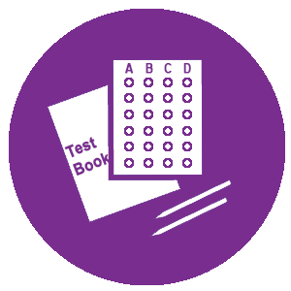

Drop-Off Reviews & Self-Study TOols
Drop-Off Reviews
Writing Assignments
Math Questions
Self-Study Tools
Video Lessons
Practice Quizzes
SkillsCenter Resource Library
Notes:
In addition to the real-time tutoring, you and your student may wish to explore some of the other tools. For example, if there is a book report due or your student is learning to write an essay, you can “drop-off” that writing assignment for a tutor to review off-line. The tutor will then send back, through your Tutor.com account, a summary of feedback with suggestions for improvement and highlights of things done well. A similar service is available for algebra questions that are stumping you or your student. Submit the question for review over night and a tutor will send you a thorough explanation of the concepts and solution.
Tutor.com also offers self-study tools. The Learn Your Way video lessons help students build a strong foundation in math and language arts. Practice quizzes can double as skills drills to help middle school students that are taking more advanced classes like algebra or gifted science. And, the SkillsCenter Resource Library provides thousands of vetted educational resources for a large variety of topics. These can include learning games, informational websites, downloadable worksheets, flashcards and more.

Slide 15

Focus on 9th-12th Grade
Notes:
High school can be fun and exciting. It can be stressful a frustrating. It gives students so many opportunities to grow, but with that growth comes challenges and each student faces his or her own challenges. What is great about Tutor.com is the flexibility and accessibility of support as well as the personalization. Whether your student is struggling and being left behind or maybe middle of the class and trying to gain some ground, or even advanced and tackling more rigorous coursework, Tutor.com can help your student take their education to the next level.

Slide 16

On-demand tutoring & homework help
Subjects Available
Math, through calculus & statistics
Science, through physics
Language Arts
Social Studies
Spanish
Computer Literacy
ACT®, AP®, PSAT®, SAT®
College Application Essays
Job Search Assistance
Notes:
The tutoring options for high school students cover sixty different subjects and test prep areas, covering all core classes plus Spanish as a foreign language and Microsoft Office. Test prep tutoring is available for the ACT, PSAT, SAT and 14 different AP courses. Tutor.com even offers tutoring for English as a Second Language and bilingual Spanish-speaking tutors for math, science and social studies. To round it all out, if your high school student is in search of a part-time job or even a job after graduation, the career coaches can assist them with their online job search, including writing a resume and preparing for an interview.

Slide 17

Drop-Off Reviews & Self-Study TOols
Drop-Off Reviews
Writing Assignments
Résumés & Cover Letters
Math Questions
Self-Study Tools
Learn Your Way Video Lessons
Practice Quizzes
AP® Video Courses
SAT/ACT Essentials
Notes:
To add to all of the tutoring options, Tutor.com provides additional tools to help students Learn Their Way. These tools can help with time management for busy students and provide instruction in different formats. For example, if your student is writing an essay for English or a paper for history, they can “drop-off” that writing assignment for a tutor to review off-line. The tutor will then send back, through your Tutor.com account, a summary of feedback with suggestions for improvement and highlights of things done well. A similar service is available for math questions from algebra up to calculus. Submit the question for review over night and a tutor will send you a thorough explanation of the concepts and solution.
Tutor.com also offers self-study tools. The Learn Your Way video lessons help students build a strong foundation in math and language arts. Practice quizzes can double as skills drills or test preparation tools for math, science and language arts. The AP Video Courses will provide your student with a second “lecture” on 330 topics covered in AP Biology, Calculus AB, US History and World History. And, if you have a college bound student, definitely introduce them to the SAT/ACT Essentials. This is a self-paced test prep course designed by The Princeton Review. It includes practice tests, personalized study recommendations, video lessons, practice drills and college admissions advice.
It’s time to take a look at how this all works! Let’s move into the Tutor.com Learning Suite.

Slide 18
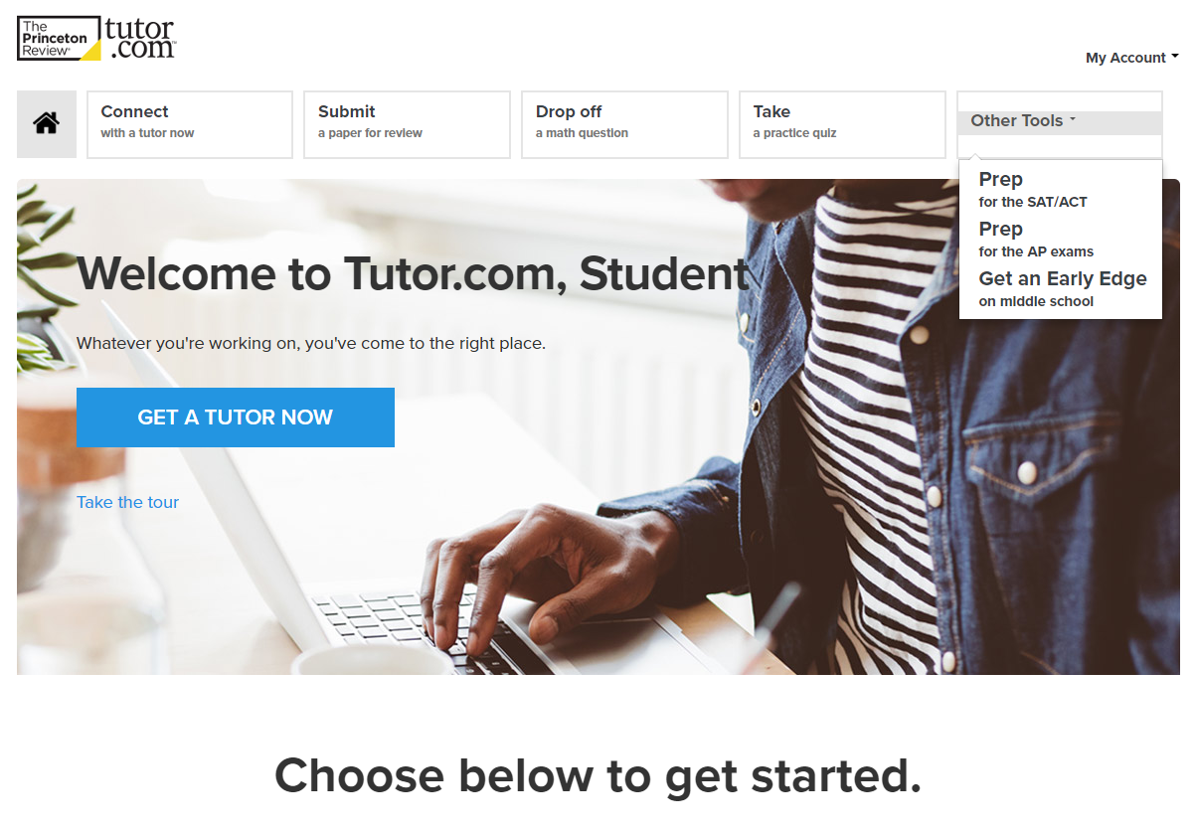
Getting Started
Notes:
Getting started is easy. You need a library card and an internet connection. Students can even use the browser on their smartphones to access Tutor.com and get connected to the help they need.

Slide 19
Logging in
Go to [enter library’s website/URL]
[Tutor.com recommends opening your library’s website and completing the demonstration “in real time, but just in case you do not have internet connection for the demonstration, we have included screenshots of all sections of the service. Delete the slides you do not wish to show/use.]
[Paste screenshot of library’s website showing link to Tutor.com.]
Do not go directly to Tutor.com’s website. Always go through the library’s website.
Notes:
Most important, do not go directly to Tutor.com’s website. Always go through the library’s website to receive your FREE access to the full Tutor.com Learning Suite. [explain how to find it on the website.]

Slide 20
authentication
[paste screenshot of library’s program login process]
Notes:
[explain how to login or authenticate]

Slide 21
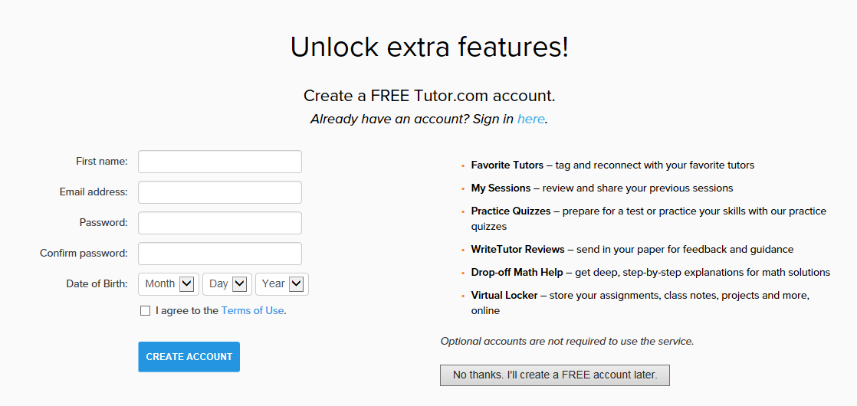
Creating an account
Personalized accounts are free.
Students still remain anonymous to tutors.
Birth Date is NOT saved, but is required for COPPA compliance.
If child is under 13, parents should create the account for full features.
Extra features and tools unlocked with account include
  Access to previous sessions
  Tag and reconnect with favorite tutors
  Store documents in virtual locker
  Use drop-off review services
  Use practice quizzes & SAT/ACT Essentials
[if your library uses SIP2 for Tutor.com authentication, you can delete this slide because accounts are automatically created. If your library requires accounts using Tutor.com’s SmartAccounts, the account creation process is similar, but all of those accounts will use Library Card Number as the username instead of email address]
Notes:
[if you use SIP2 authentication, skip this slide]
[if your library sets per user limits, accounts are required. Contact ClientSupport@tutor.com to confirm your program’s setup if you’re not sure.]
You’ll be asked to create a Tutor.com account. Accounts are free, anonymous and optional. If your student is under 13 years old, please create this account using your information. Otherwise, the extra features will not be available for your student.
If you don’t want to create an account, just click “No thanks,” but doing so will limit the features available. You’ll only be able to connect with a tutor for the live, on-demand tutoring, view video lessons or access the SkillsCenter Resource Library. You will not be able to use the drop-off review service, practice quizzes, or SAT/ACT Essentials and you won’t have access to your favorite tutor list, previous sessions or virtual locker.

Slide 22
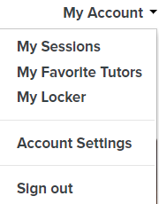
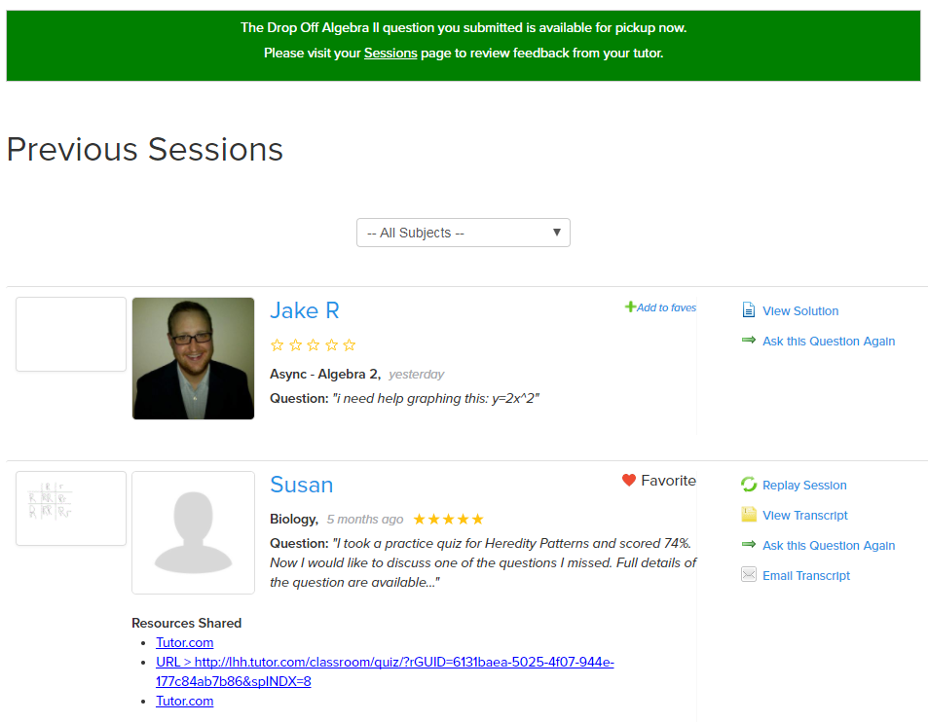
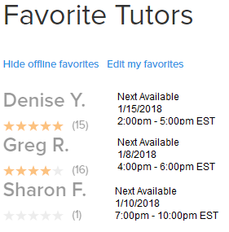
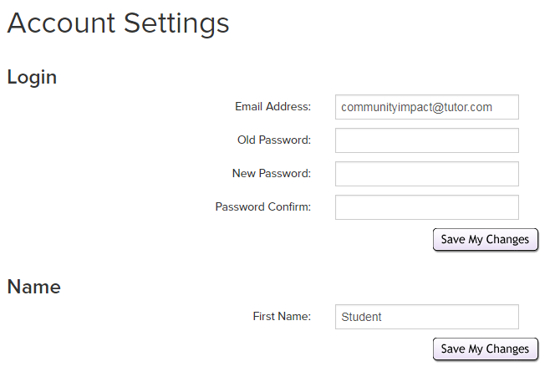
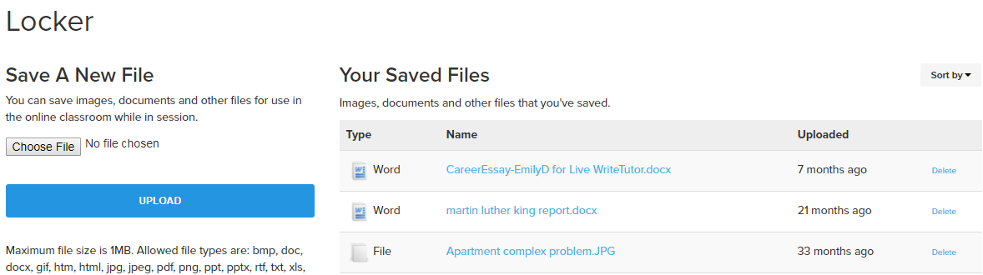
Reviewing child’s work
Parents can review their child’s work through “My Account.”
  Previous sessions
  Favorite tutors
  Stored documents in locker
Password can be changed in “My Account.”
Email address can be updated in “My Account.”
Families can share accounts, but it is not recommended for older students, as they will want to store and review their self-study progress.
Notes:
[for parents, not teachers]To monitor your student’s use of Tutor.com and the sessions they complete, log into their account and go to “My Account.” here you will see options to review their previous sessions, their favorite tutor list and all of the documents they’ve shared within their sessions. This is also where students will go to retrieve the results from their Drop-Off Reviews. This library of previous sessions and documents can be a great help to students who are reviewing for upcoming tests or would like to “see it one more time,” because each real-time session record includes a video playback option and an audio transcript if they chose to use voice-chat.

Slide 23
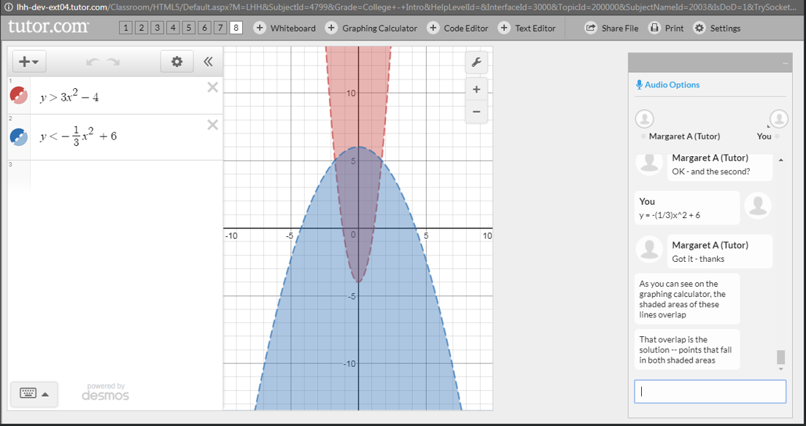
Using the tools
Notes:
Now, you’re signed in and you’ve setup your account. Let’s look at the tools that are available and where to find them.

Slide 24
Delete this slide prior to presentation
When presenting to parents/teachers of K-5th grade students, show the following tools or slides:
Choose your tool, connect with a tutor, classroom tools, post-session review, skillscenter
When presenting to parents/teachers of 6th-8th grade students, show the above tools or slides plus:
Drop-off reviews, practice quizzes, early edge video lessons
When presenting to parents/teachers of 9th-12th grade students, show all tools or slides.

Slide 25
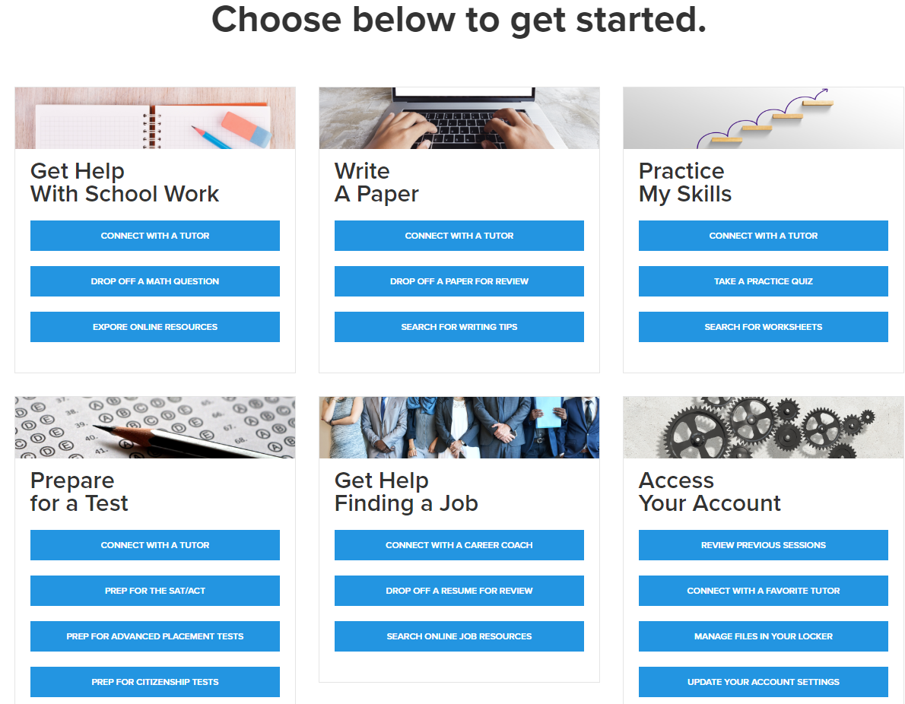
Choose your tool
Learn Your Way
with video lessons
Notes:
The Tutor.com landing page is designed for ease of use, highlighting the different tools available for each task with which you may need help. You can either use the quick links on top to choose your tool or, you can scroll down to the “toolboxes” that show the different learning tools available for the task at hand. Anytime you wish to return to this page, just click the little house icon in the top left corner. Now though, we’ll start with the most frequently used tool, connecting with a tutor. Just click on Connect with a Tutor.

Slide 26
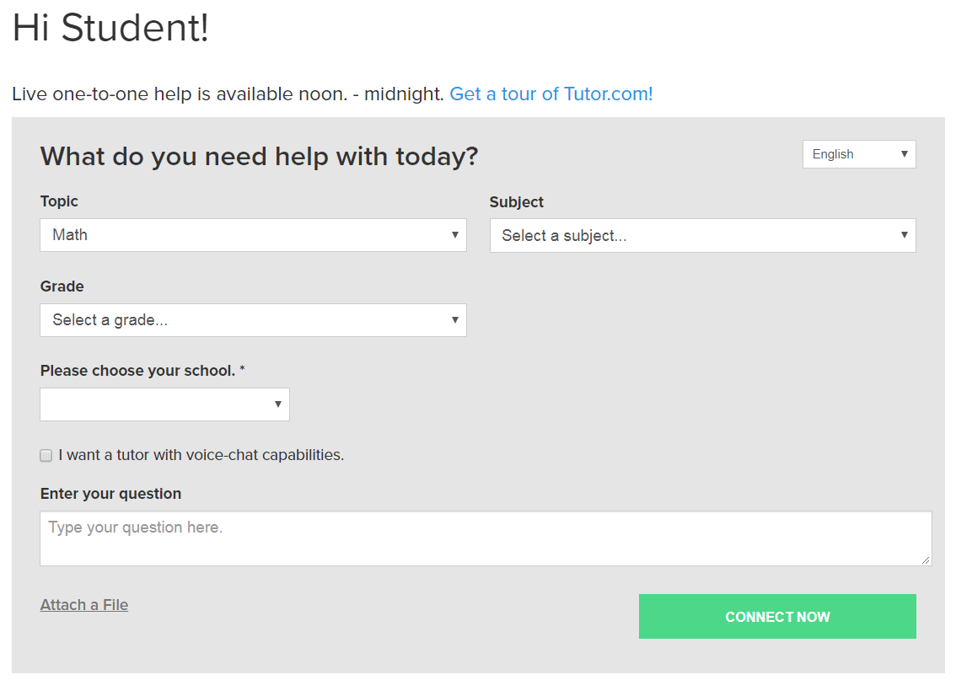
Connect with a tutor
Tutors are available [enter tutoring hours and days.]
Spanish speaking tutors are available for math, science and social studies.
To allow a voice connection in the classroom, be sure to check the box for “voice-chat capabilities.”
Average wait time to connect is under 2 minutes.
Average session length is 20-25 minutes, but might be shorter or longer depending on student’s needs.
Notes:
Connecting with a tutor is easy! Our Library’s tutors are available –---. To get connected, just answer the few questions that are in the pre-session connection box. It is always helpful if you include your full question instead of just “HELP,” as Tutor.com uses this information to connect you with the most appropriate tutor for your question. Also, if you think you might want to use the voice/audio option while in session, be sure to check the box. You’ll still have the option to turn on audio once in the classroom, but checking this box makes sure that option is available to you.
To connect with a bilingual Spanish speaking tutor, just use the language toggle in the upper right corner of the questionnaire.
Once you click “Connect Now,” the average time to connect with a tutor in the classroom is under 2 minutes.

Slide 27
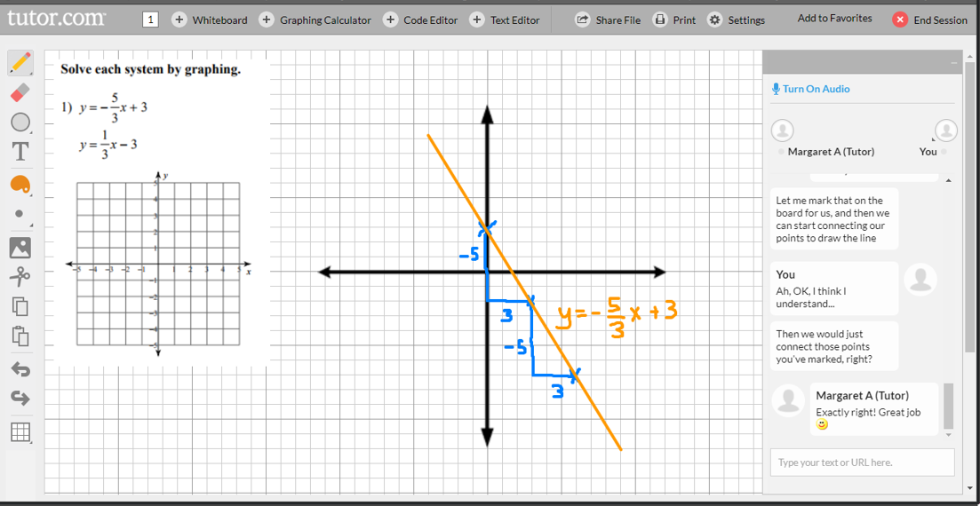
Classroom tools
Chat and voice
Interactive whiteboard with drawing tools
Graphing calculator
Text editor
File sharing
Online resource sharing
Print from classroom
Change font size in settings
Notes:
Once in the classroom, you and the tutor use the chat box to instant message back and forth or turn on audio to speak with a tutor. You will also use the interactive whiteboards where both you and your tutor can draw out problems, type an outline, graph an equation and much more. The tutors can also share educational online resources in the classroom to supplement the discussion. Tutors review all websites for appropriate material before launching. Also, the links to all shared resources are available in the post-session transcript for bookmarking and review.
Access all of these extra tools using the plus-sign buttons on the top of the classroom.

Slide 28
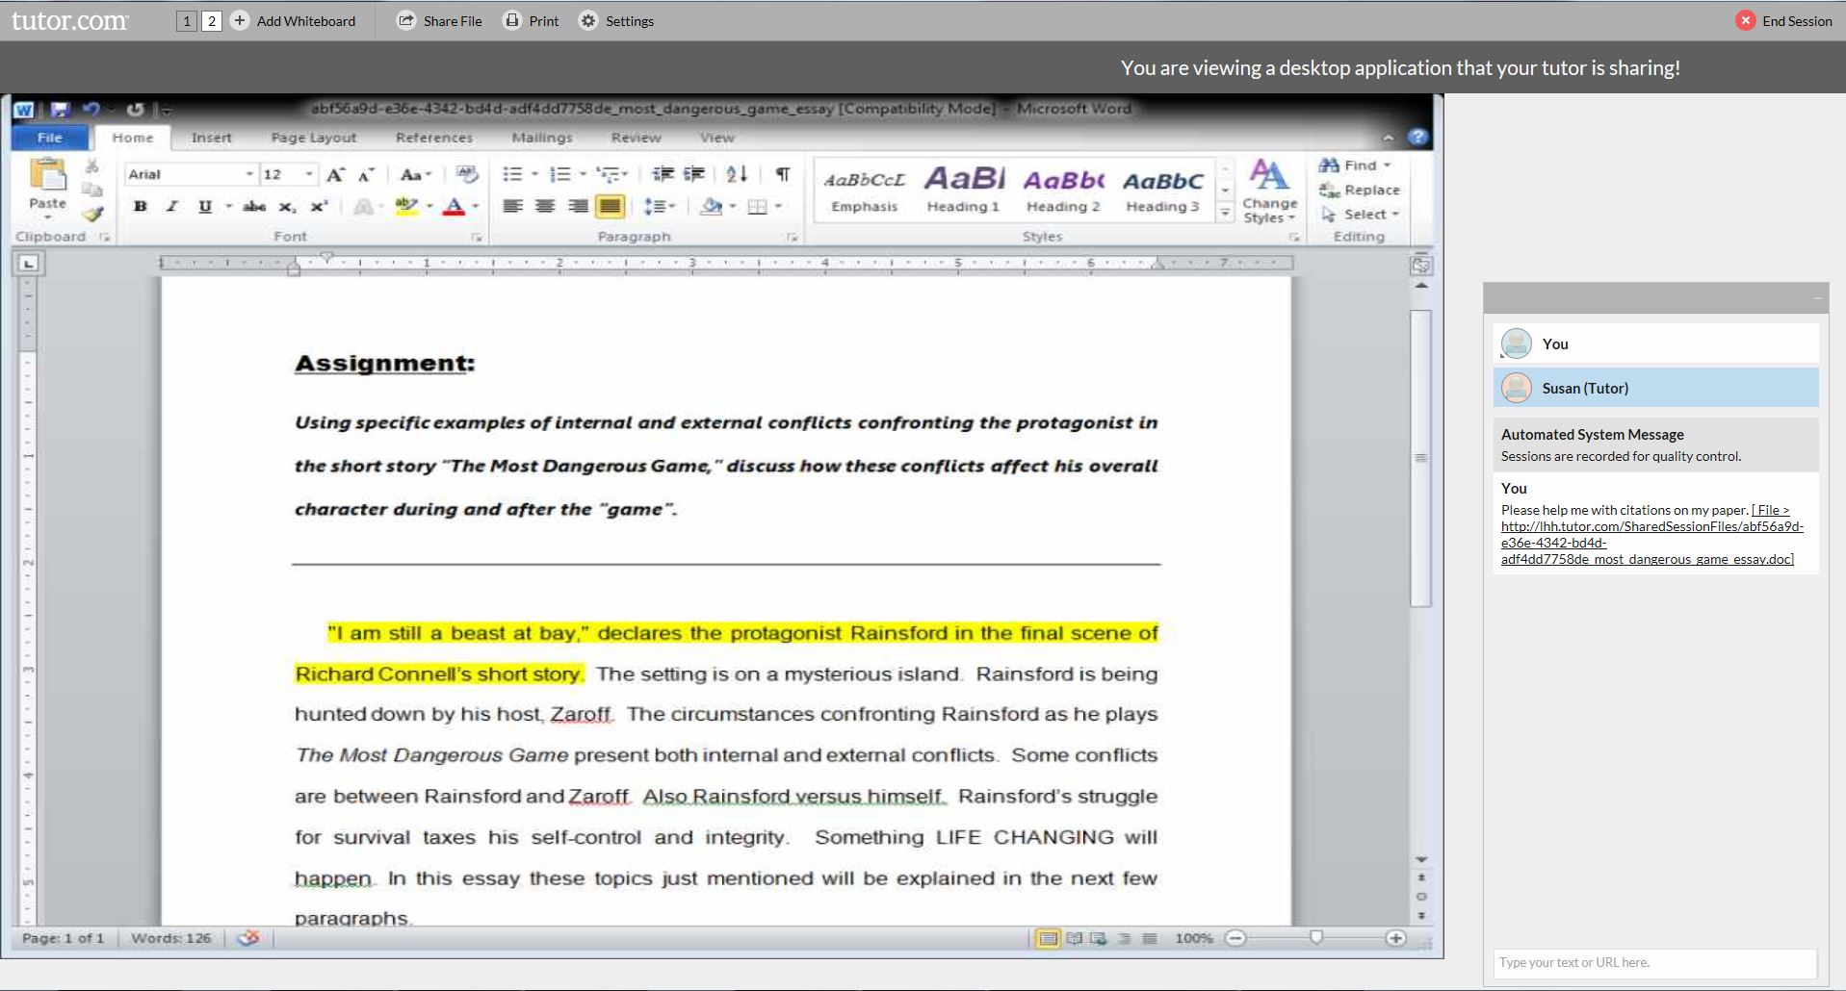
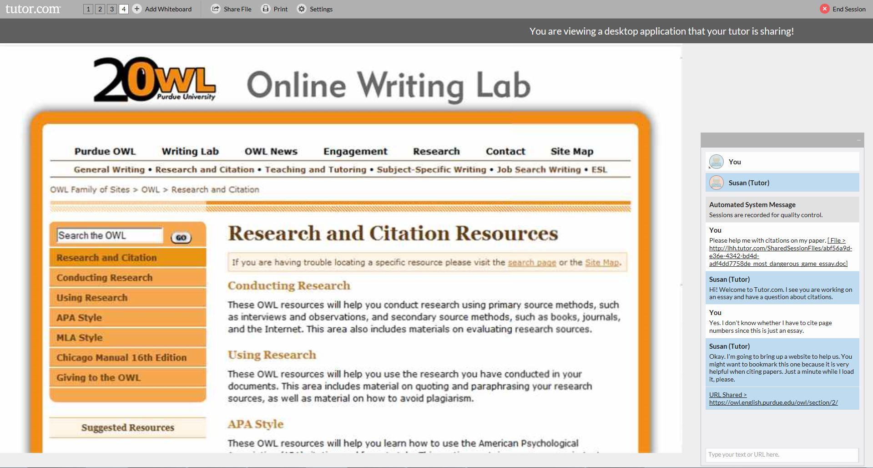
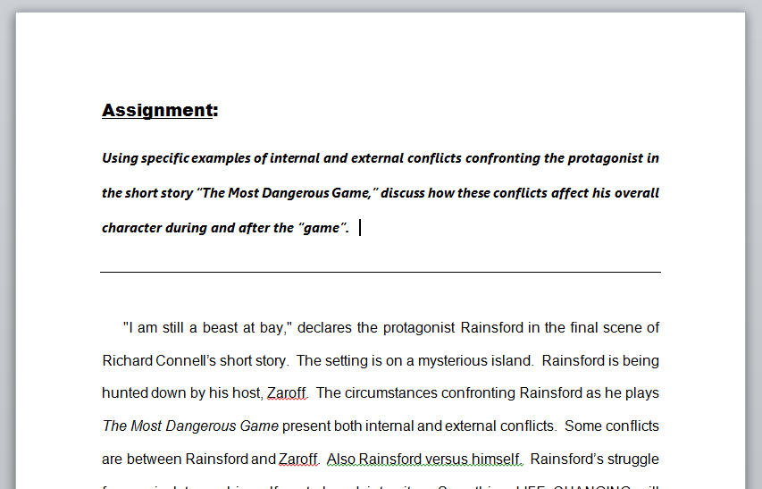
Classroom tools
Shared viewing of files & applications
Writing assignments
Lab reports
Class presentations
Résumés & cover letters
Learning Microsoft Office®
Word®
Excel®
PowerPoint®
Microsoft Office and related products are registered trademarks of Microsoft, Inc.
Notes:
Another great feature in the online classroom is the ability to share and simultaneously view files such as Microsoft Word, Excel and PowerPoint files or PDFs. This feature allows you and your tutor to discuss the file while both being “on the same page.” Also note that when sharing files, the actual software is viewable, like we see the MS Word controls in this example. This allows the tutors to show you how to use the software tools to format their papers, create charts for a lab report, animate a presentation for speech class and more.

Slide 29
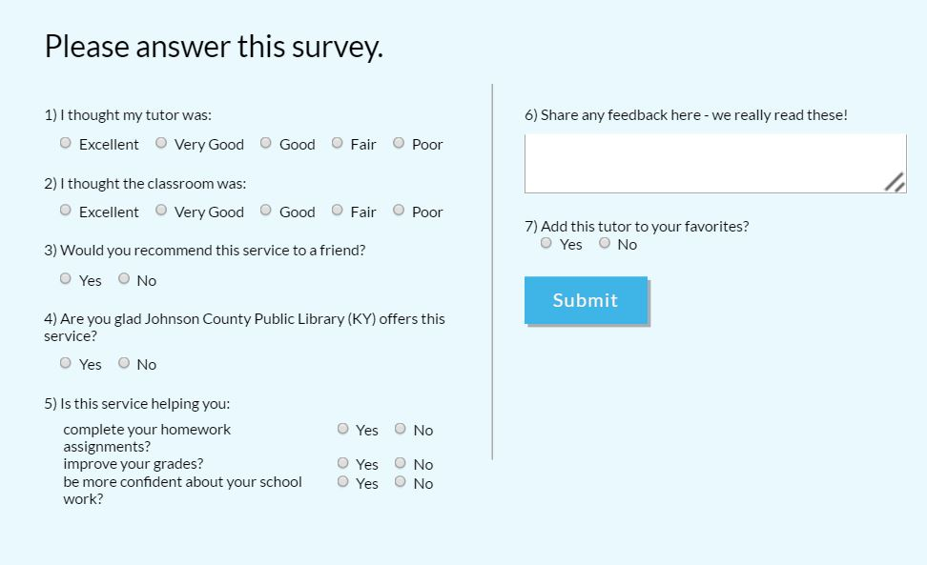
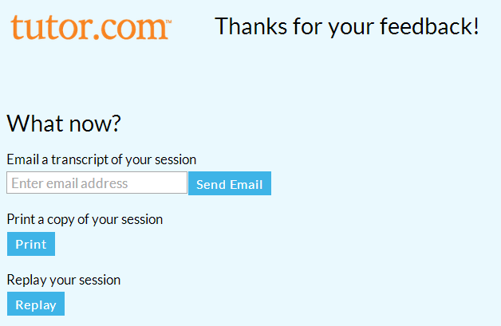
Post-session review
Please complete survey every time. It is used as part of the quality control process.
After session, you may email the session transcript, print it or replay a video of the session.
Notes:
Lastly, once a session has ended, please complete the survey and review your session. All survey results are shared with the library and Tutor.com uses these survey results and student comments for quality control purposes.
If you did not create an account, the session transcript review is very important because once you close this window, the session is no longer available without an account. You can email a copy of the session, print it or replay a video of the session.
[this is a good time to pause for questions before getting into the other tools]

Slide 30
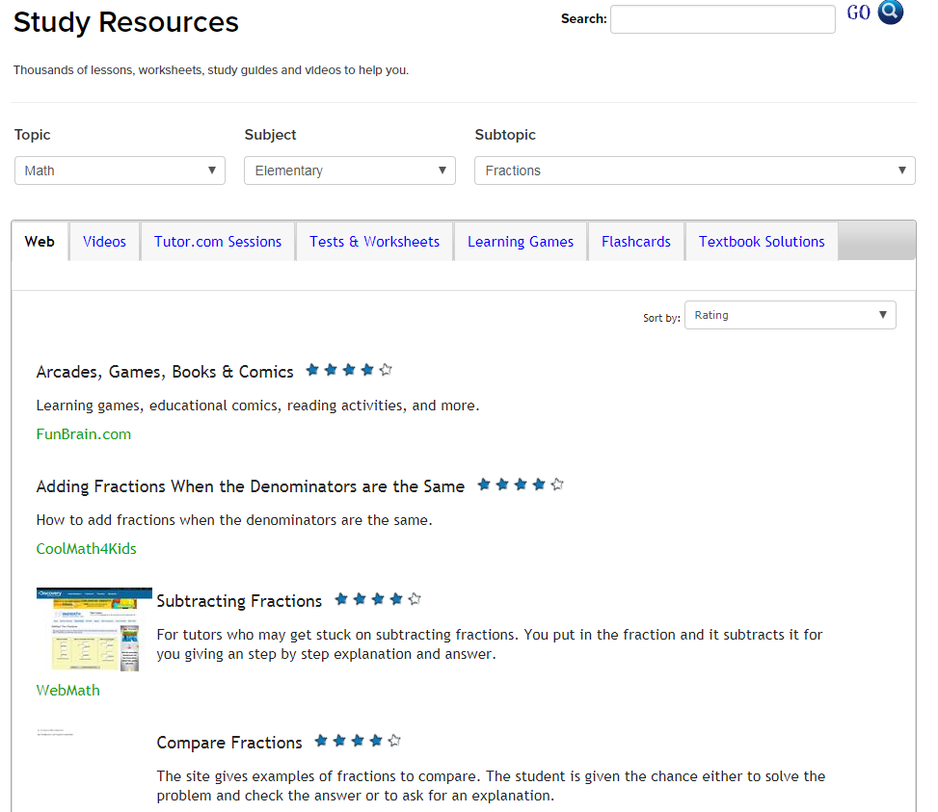
SkillsCenter™ Resource Library
Access from landing page
  “Explore online resources”
  “Search for…”
Or, access from bottom of “Connect with a tutor” page
Thousands of vetted, educational resources
  Websites
  Videos
  Tutor.com Sessions
  Sample Tests & Worksheets
  Learning Games
  Flashcards
  Textbook Solutions
Notes:
Next, let’s take a look at the SkillsCenter Resource Library. This is available 24/7 and you can access the SkillsCenter from the Task with Tools page or at the bottom of the Connect with a Tutor Page and includes three sections: Study Resources, Test Prep Resources and Career Resources. The SkillsCenter can be searched using key words or a drop-down navigation tree. It includes thousands of online resources from education companies and career experts. Depending on the topic searched, you can find informational websites, instructional videos, previously recorded Tutor.com sessions, sample tests & worksheets, customizable flashcards and learning games. The SkillsCenter Resources are available 24/7.

Slide 31
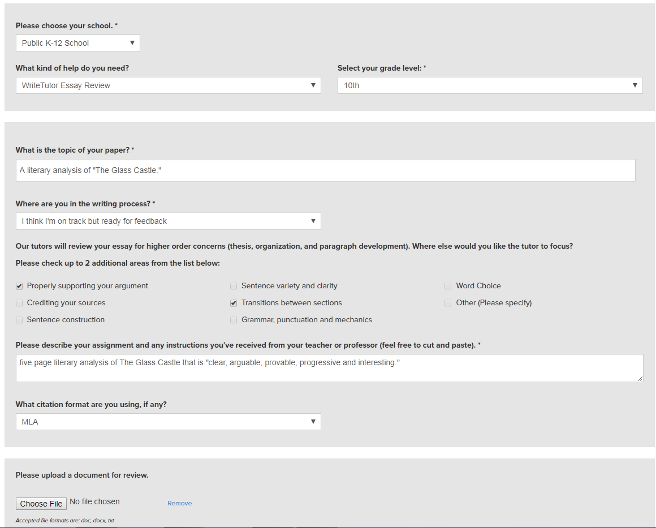
Drop-off Reviews
Available for writing assignments, single math questions (algebra and up) and cover letters/résumés.
Writing & Job Search open 24/7 for submission
  Turn-around time under 12 hours.
  Limited to 5,000 characters per submission.
Math open during regular tutoring hours for submission.
  Turn-around time under 24 hours.
  Limited to one problem at a time.
Complete the pre-session questionnaire and upload your document.
Reviews returned to the “My Sessions section” once completed. Email notification sent.
Notes:
Moving onto the next tool, we have the drop-off reviews. Drop off reviews are a fantastic way to get feedback and guidance from a subject matter expert without having to connect for a real-time session. This is great for students who are pressed for time or who may nervous about a real-time conversation with a tutor.
The writing and resume drop off service is open 24 hours/ 7 days a week and the turn around time for feedback on a piece of writing is under 12 hours. This is for K- adults and there is a 5,000 character limit per submission. Students will get back a detailed feedback form and suggestions on the document itself offering tips, kudos, and suggestions for next steps.
The math drop off service is open during tutoring hours and is for algebra through calculus. There is a one problem at a time limit and the turn around time is 24 hours. This tool is especially helpful for students that prefer words & pictures instead of numbers & symbols when learning math, and for anyone looking for another way of having the concepts presented. A good example for when to use the drop-off math review service is if you miss a question on a quiz and you know it is coming up on a test and you just can’t understand why you missed it.

Slide 32
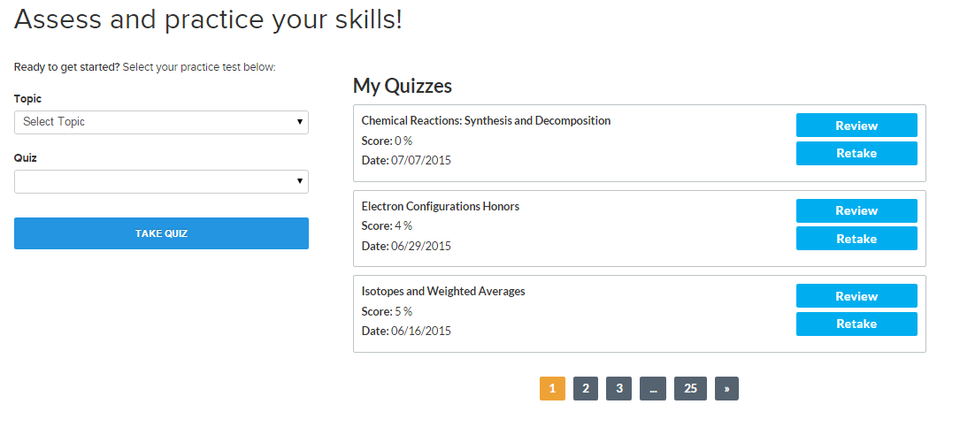
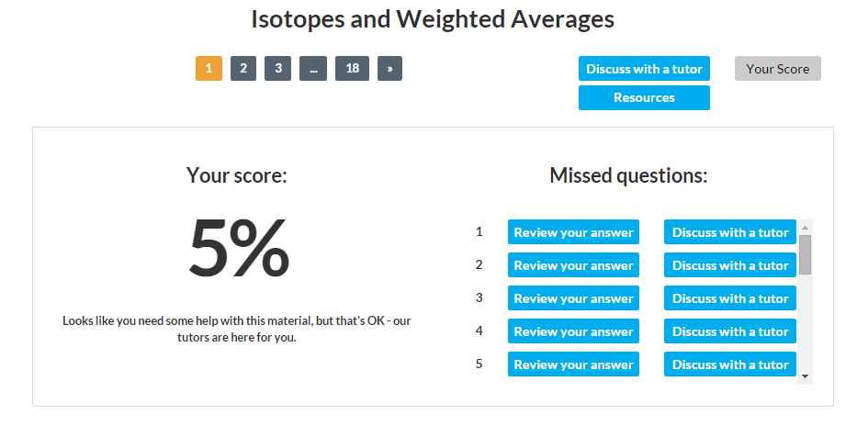
Practice quizzes
Middle School/High School/College
  Math Fundamentals
  Algebra I
  Geometry
  Algebra II
  Calculus
  Biology
  Chemistry
  Physics
  English/Language Arts
Use as skills builders or to prepare for an end-of-chapter test.
Notes:
Next on the list are practice quizzes. These can double as skills drills, too. Practice Quizzes will help you prepare for upcoming end-of-chapter tests or practice your skills in particular areas of math, science and language arts. These quizzes are geared for late middle school, high school and early college levels. Each quiz is about 15-30 questions long, depending on the depth of the topic. You’ll receive a score report after completing the quiz that includes a list of all missed questions. Then, you have the option of reviewing the correct answer, opening a resource related to that topic or discussing the question with a tutor.

Slide 33
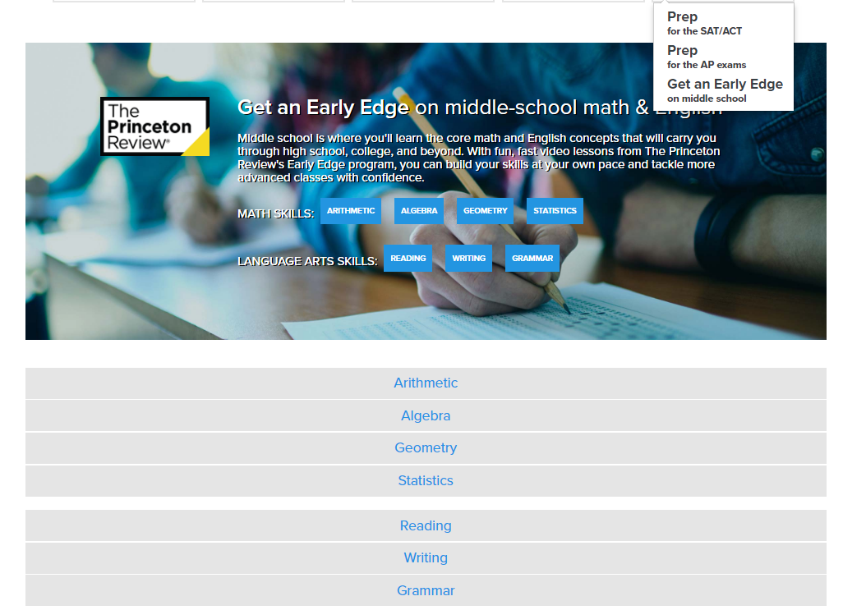
Learn Your Way video lessons
  Math Videos (65 lessons)
    Arithmetic
    Algebra
    Geometry
    Statistics
  English Language Arts (37 lessons)
    Reading
    Writing
    Grammar
Each video is about 5 minutes long.
Use as skills builders or to prepare for an end-of-chapter test.
Learn Your Way
with video lessons
Notes:
Having a strong foundation of knowledge and skills is necessary for any student to succeed, yet there are many students that are missing the fundamentals. The Learn Your Way video lessons created by The Princeton Review were designed to help students learn and review the fundamentals needed to tackle more advanced classes. Each video is less than five minutes long and presents just one concept. Students from around 4th grade and up can use these videos to be introduced to new concepts or to review a concept. When used in combination with the Practice Quizzes we just saw and with the tutors, students are able to build the skills they need at their own pace and tackle more advanced classes with confidence.

Slide 34

AP® Video Courses
High School/College Level
Advanced Placement Courses
  Biology (107 lessons)
  Calculus AB (54 lessons)
  U.S. History (102 lessons)
  World History (70 lessons)
Each video is less than 15 minutes long.
Broken down into chapters/topics.
330 videos in total.
Don’t forget, tutors are available for on-demand tutoring in 14 AP subjects.
Learn Your Way
with video lessons
Notes:
Speaking about those advanced classes, Advanced Placement courses have a lot of great advantages. Students can earn college credit if they perform well on the AP test. AP course grades are often weighted higher than regular courses. Universities look for students that have taken multiple AP or “rigor” courses. These courses can help prepare students for fast paced, more difficult college courses. But…these classes can also be risky. If students take them before they are ready, before they have the foundational knowledge and skills, reaping the benefits is impossible. The Tutor.com Learning Suite includes 330 videos created specifically for AP course material to help students truly grasp the concepts and ace their AP course and test. The video libraries include biology, calculus, U.S. history and world history.

Slide 35
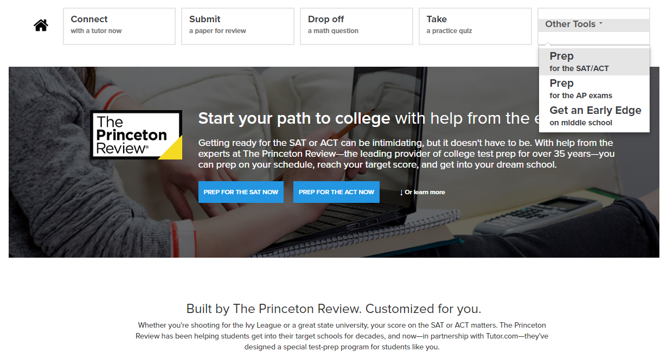
Sat/act essentials – test prep
Created by The Princeton Review
SAT and/or ACT Prep
Full-length practice tests
Comprehensive score report with “Areas of Focus”
Video lessons & practice drills
College Admissions Advice and Resource
Learn Your Way
with video lessons
Notes:
Lastly, I want to show you the SAT/ACT Essentials. This tool is truly Essential for any high school student with dreams of going to college. Good scores on the SAT and ACT can not only help a student get into the school of their dreams, but also help them earn scholarship money. This self-study course from The Princeton Review can help your students prepare for the tests and raise their score. Students can choose to prep for the SAT, the ACT or both. Prep for the SAT can also help 10th and 11th grade students prepare for the PSAT/NMSQT if they plan to shoot for a National Merit Scholarship. To get started, students click on “Prep for the SAT/ACT” and then choose the test they’d like to take.

Slide 36
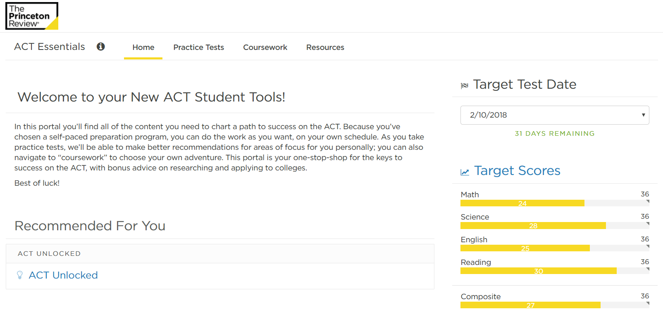
Sat/act essentials – test prep
Start by setting targets and watching the introductory video on Home page.
Notes:
Once the test is chosen, the homepage presents an introductory video for the test, briefing students on strategy. From there, they set their target test date and scores so that they can track progress toward goal.

Slide 37
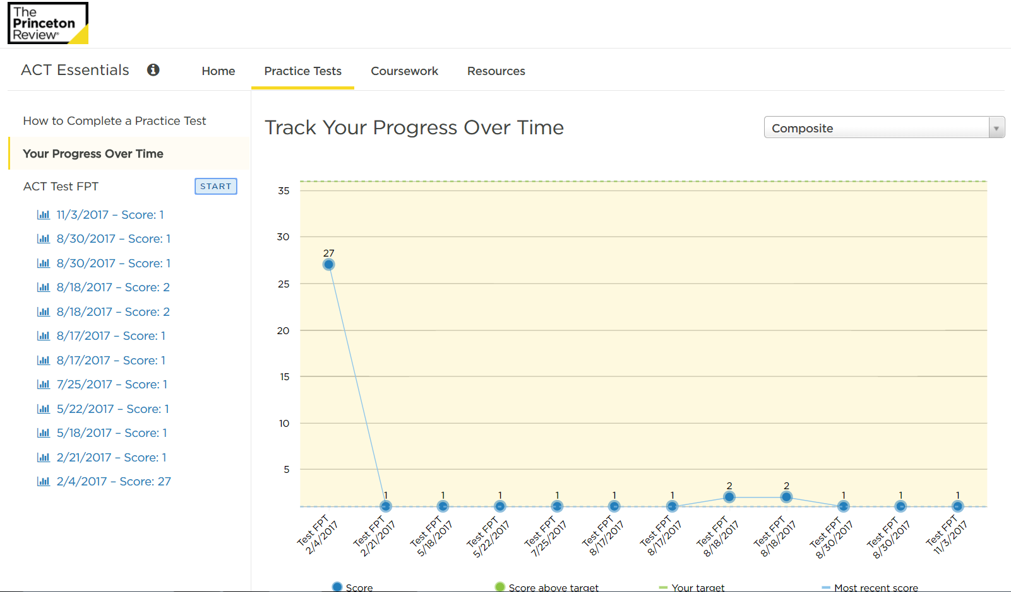
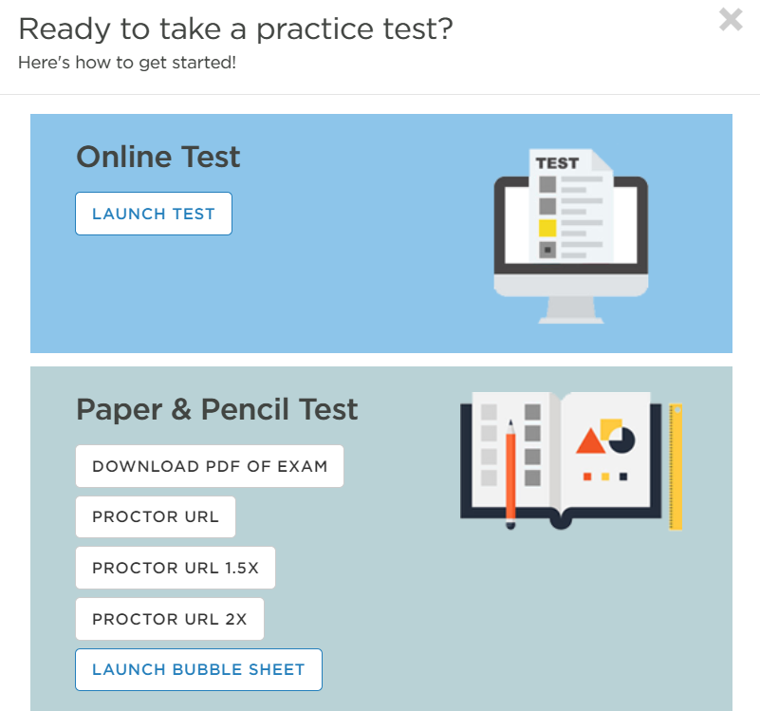
Sat/act essentials – test prep
Take practice test
  Online or download test and bubble sheet
  Choose format
    Timed, time-and-a-half, double-time, untimed
  May end test after one section to score just that section
Notes:
Click on the practice test tab to get started. Practice tests are full length tests that mimic the actual tests, using the same number of questions as the real test and timed in the exact same way. Students can choose to take the tests online or download a paper version. If your student uses the paper version, they will have to transfer their answers from the bubble sheet into the online system to retrieve their score. Once the student completes the test, they’ll receive a full score report.

Slide 38
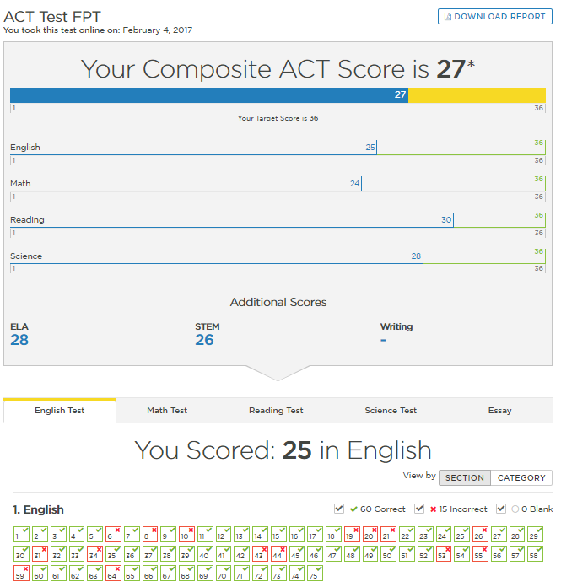
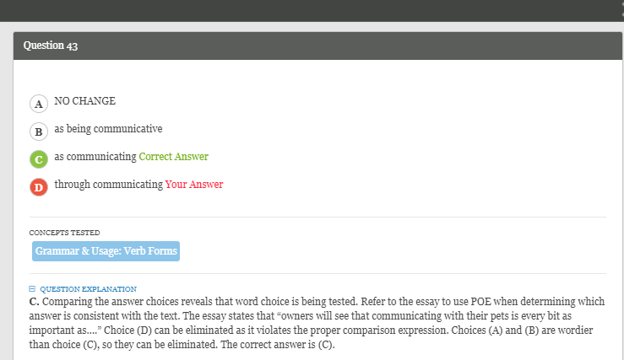
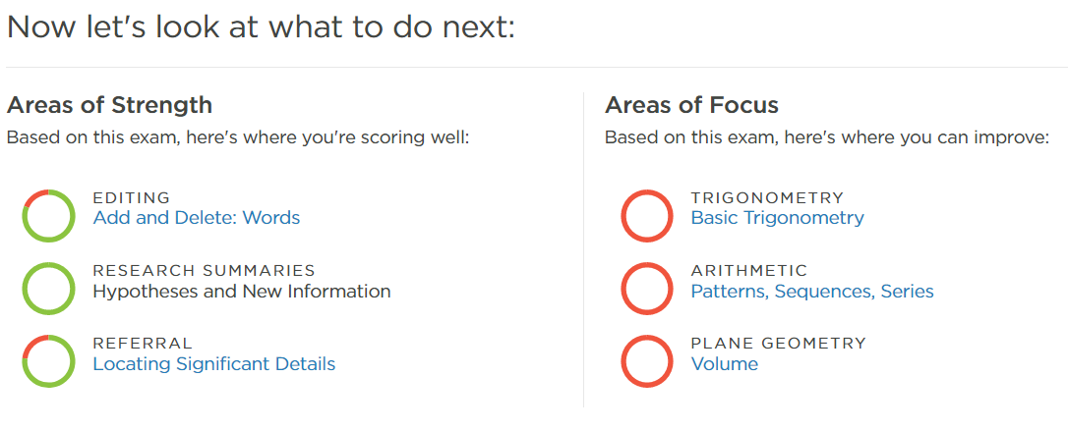
Sat/act essentials – test prep
Use Score Report to review missed questions and receive explanations of concepts.
Use Areas of Focus to best improve score.
  Each area of focus has a video lesson and practice drill.
Notes:
The score reports show what the student would have scored on an actual test, breaking the results down into sections as well as giving question by question results. Students can click into each question to see the correct answer and an explanation for the question. Most importantly on the score report, your student will be provided with Areas of Focus. These areas of focus show the concepts students should master to improve their score the most. Clicking into each area of focus will provide a video lesson and practice drill for that concept.

Slide 39
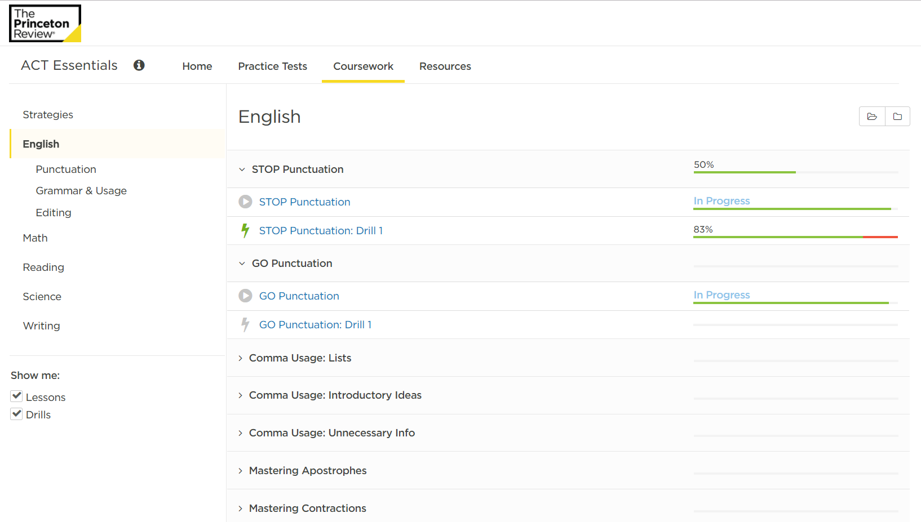
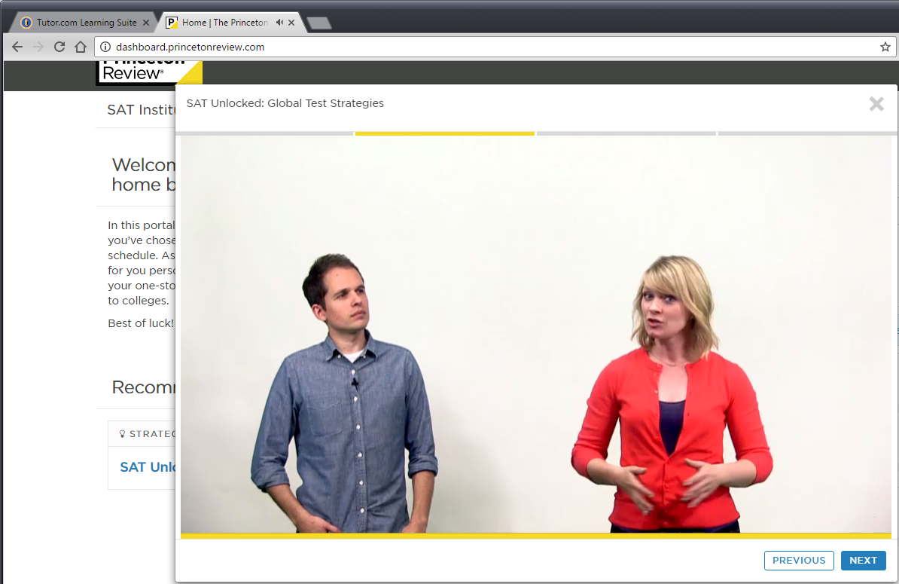
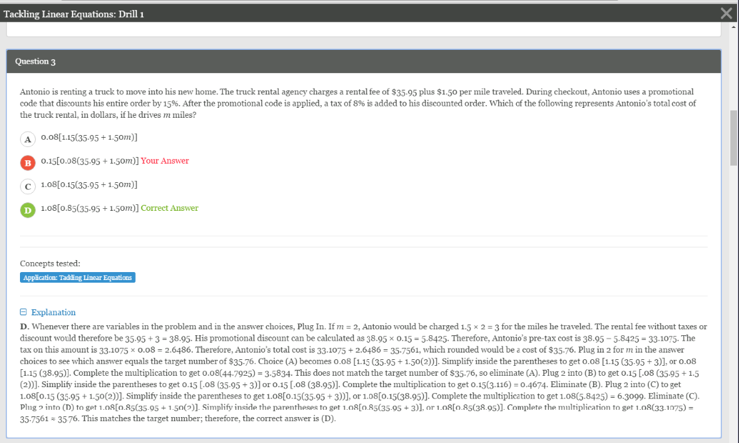
Sat/act essentials – test prep
Additional prep available on Coursework tab
90 ACT Lessons
90 SAT Lessons
Video & Drill for Each
Connect With a Tutor
Flip Back to Tutor.com tab in your browser for help from an on-demand, subject-matter expert if you don’t understand any questions or concepts from the video lessons or practice drills.
Videos & Drills
Notes:
After working on the areas of focus, students can choose to retake the practice test to receive new areas of focus or they can click into the Coursework tab to find video lessons and practice drills for every single concept that is covered on the tests. There are 90 different video lessons and practice drills for each test. Remember, if your student ever gets stuck on a concept and needs more help, they can flip back to the Tutor.com Learning Suite home page and connect with a subject matter expert to help them understand the concepts.

Slide 40
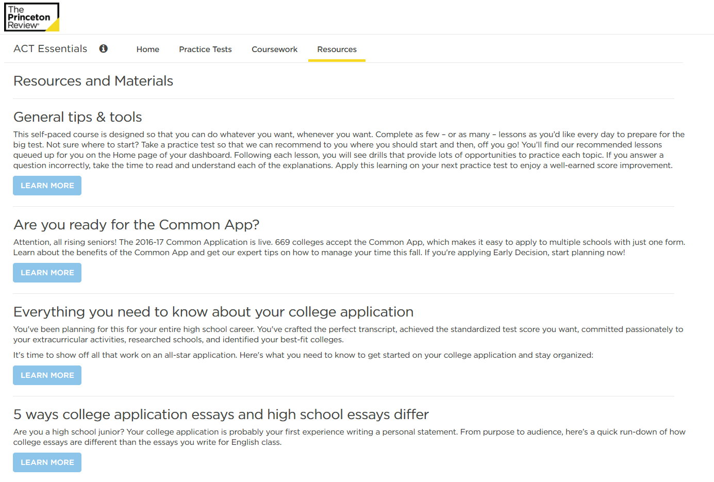
Sat/act essentials – admissions advice
College admissions advice from The Princeton Review available on the Resources tab.
The Common App
Applications
Writing Your Essays
Choosing Your School
Choosing Your Major
Financial Aid
Test Strategies
GPA & High School Classes
Notes:
In addition to good test scores and grades, the college admissions process can also include a lengthy application, required essays and, of course, financial aid. The Resources tab in SAT/ACT Essentials provides advice from The Princeton Review college admissions experts on how to navigate the college application process. Be sure to check it out!

Slide 41

Questions & contact
[Insert the contact information for the library]
If presenting to teachers, show the link to the Client Resource Center:
www.tutor.com/clientcarelib
Notes:
That was a lot of information! The Tutor.com Learning Suite truly is a great resource for students of all ages. By providing instruction and tools in so many different formats and subject areas, it appeals to many learning styles and provides the one-to-one support that most students cannot get today from school or home. Do you have any questions about the Learning Suite that I can answer for you now?

